Slide 1
On Time or Not?
Predicting Delivery Delays on Brazil’s largest e-commerce platform, Olist
Chentong Hao
October 24, 2025
Data Science Institute
https://github.com/chentonghao/Midterm
Notes:
Hi everyone, I’m Chentong Hao from Data Science Institute,.
My project is about predicting delivery delays on Brazil’s largest e-commerce platform, Olist.

Slide 2


1 Problem Introduction
🤯
Have you ever ordered something online, checked the tracking page five times a day,and still wondered — “Why hasn’t my package arrived yet ???”
Problem Definition:
Predict whether an e-commerce order will be delivered on time.
Why It Matters:
Delivery punctuality → key to customer satisfaction
Late orders → harm seller reputation
Accurate delay prediction → optimize logistics operations
Type of Task: Binary Classification
Target: is_late (actual delivery date VS the estimated delivery date)
1 → Delivered after estimated date
0 → Delivered on time
Notes:
I chose this dataset because I’m interested in e-commerce, and delivery time is a key part of customer experience.
Late deliveries can hurt both customer satisfaction and seller reputation,
so my goal is to predict whether an order will arrive on time or be delayed.
This is a binary classification problem, and my target variable is is_late.
I created is_late by comparing the actual delivery date with the estimated delivery date.

Slide 3


2 Dataset
Source: Olist — Brazil’s largest e-commerce platform
Public release on Kaggle (Olist data-sharing initiative)
Real transactional records from 2016–2018
Each row = one real order
Three challenges:
Large: over 100k orders and multiple linked tables.
Non-iid : multiple orders come from the same customers
(each order is an independent sample in my task)
Some tables contain missing values(<0.1%) .
Notes:
The dataset was publicly released on Kaggle as part of data-sharing initiative.
The data contains real transactional records from 2016 to 2018,
and each row represents one actual order placed on the platform.
The main challenges are, first, the dataset is large and comes from multiple linked tables — such as orders, customers, sellers
Since these were provided as separate CSV files, I used what I learned from DATA1050 merge and preprocess them into one dataframe them before analysis.
Second, the dataset itself is not fully IID.
But for later splitting and modeling, since my task in on order level, each order is an independent sample.
And finally, there are few missing values, less than 0.1% in only 4 columns.

Slide 4
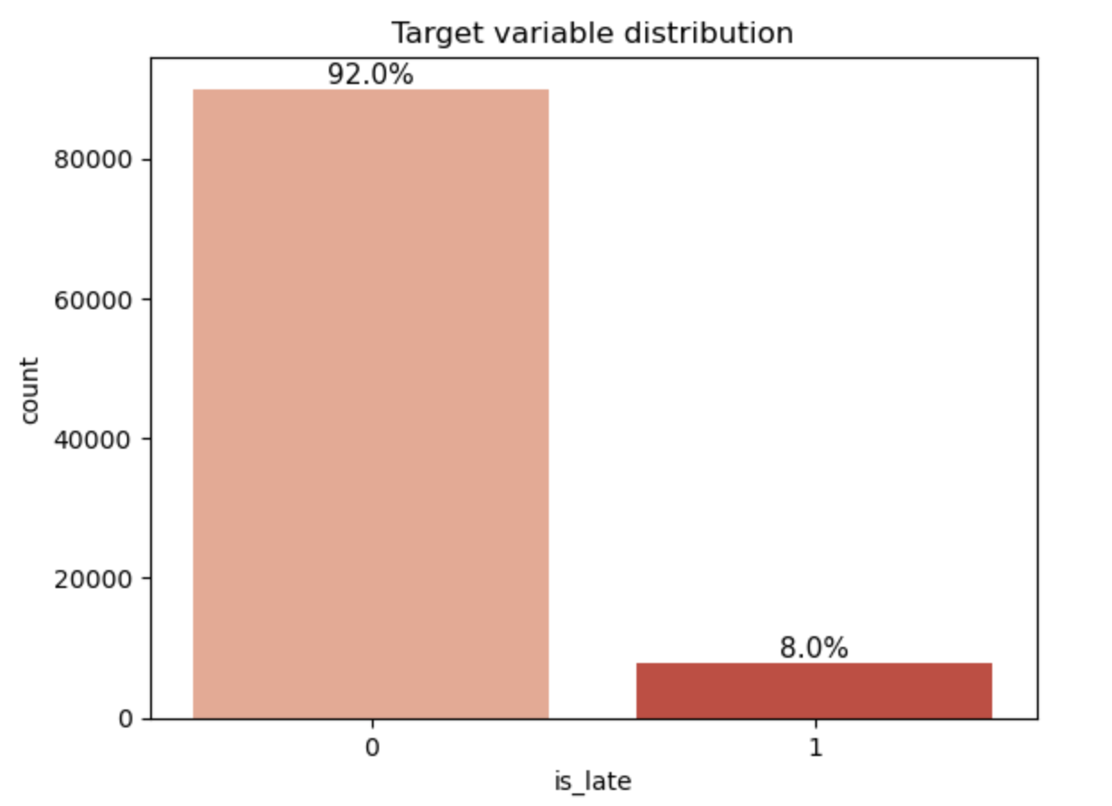
3 EDA
A strong class imbalance
Notes:
The first figure shows the distribution of my target variable.
As you can see, the data is quite imbalanced — most orders were delivered on time.
To address the imbalanced problem I plan to use techniques like class weighting.
And when evaluating performance, I’ll focus on the F1 score instead of accuracy,

Slide 5

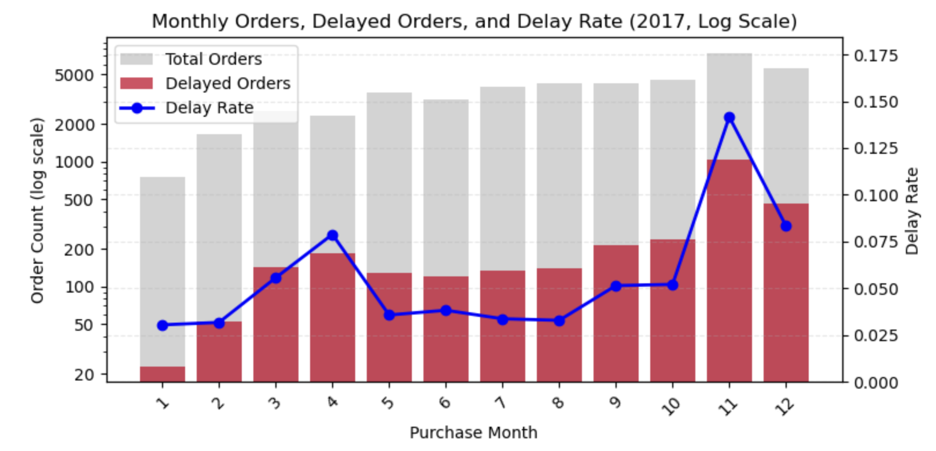
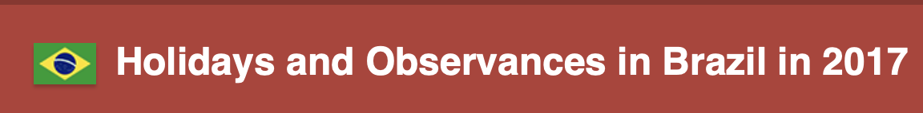
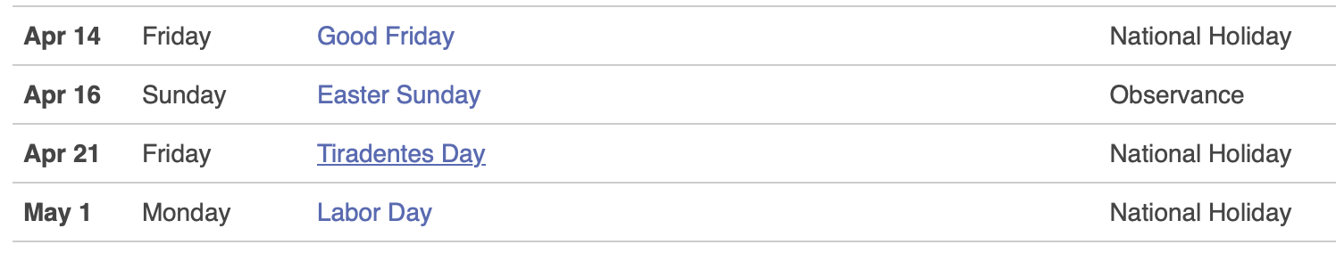
3 EDA
Delay peaks in November (Black Friday)
Second spike in April (National public holidays)
Holiday/Shopping Period cause?
Notes:
This is one of the most interesting findings from my EDA.
The x-axis shows the purchase month, and the left axis shows total and delayed orders.
The blue line on the right is the delay rate.
We can see two main peaks — one in April and another in November.
The November rise coincides with Black Friday, when order volume surges and delays become more common.
The April spike may be linked to several national holidays in Brazil.
That’s when many people are off work and logistics slow down.

Slide 6
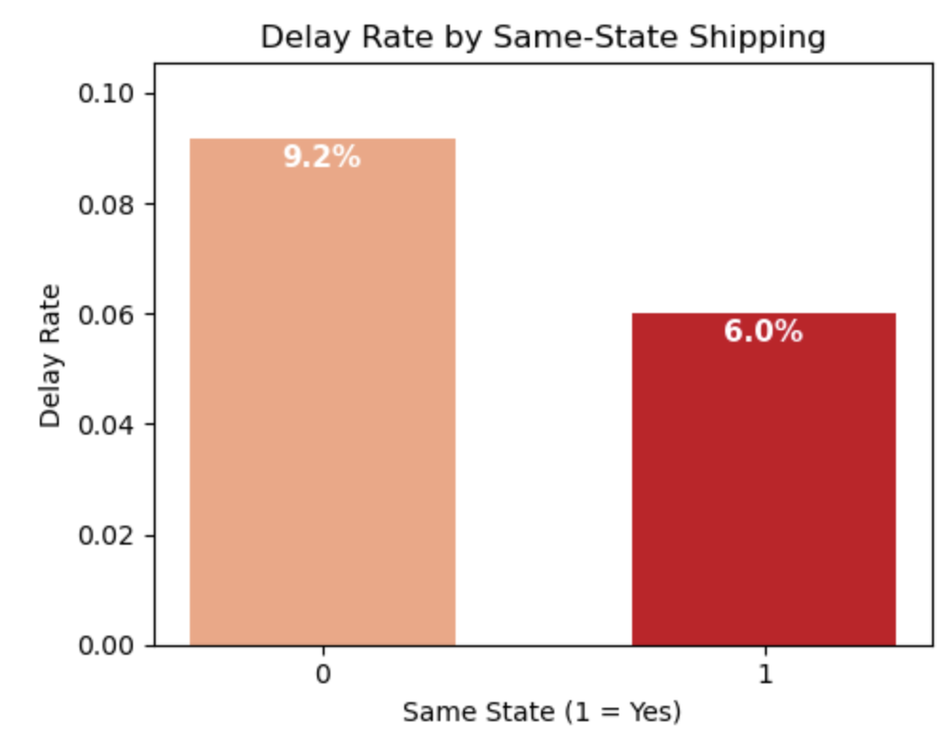
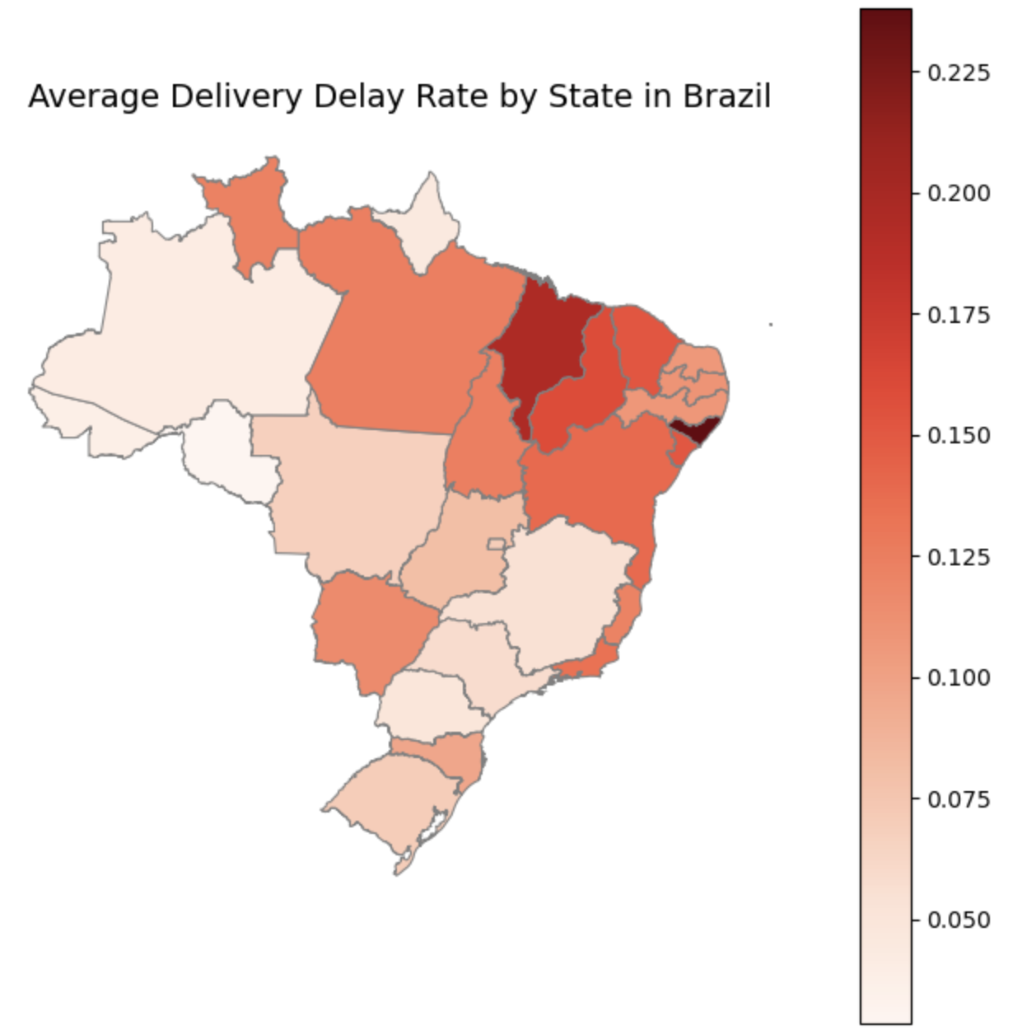
3 EDA
Cross-state orders → higher delay rate
Same-state orders → fewer delays
Shipping distance likely main factor
Notes:
I also wanted to explore whether geography plays a role in delivery delays.
On the left, we can see that same-state orders have a much lower delay rate, which makes sense.
I mapped the average delay rate by state.
We can see that the northeastern region has noticeably higher delay rates.
This area is generally less developed in terms of logistics and infrastructure,
which could explain the slower deliveries.
So overall, location seems to be an important factor behind delivery performance.

Slide 7
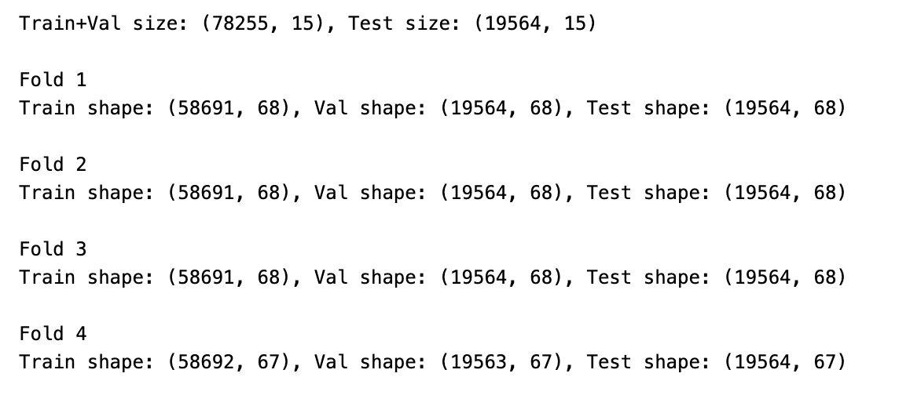
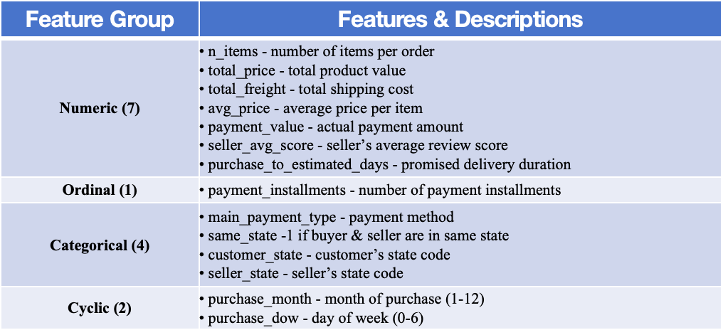
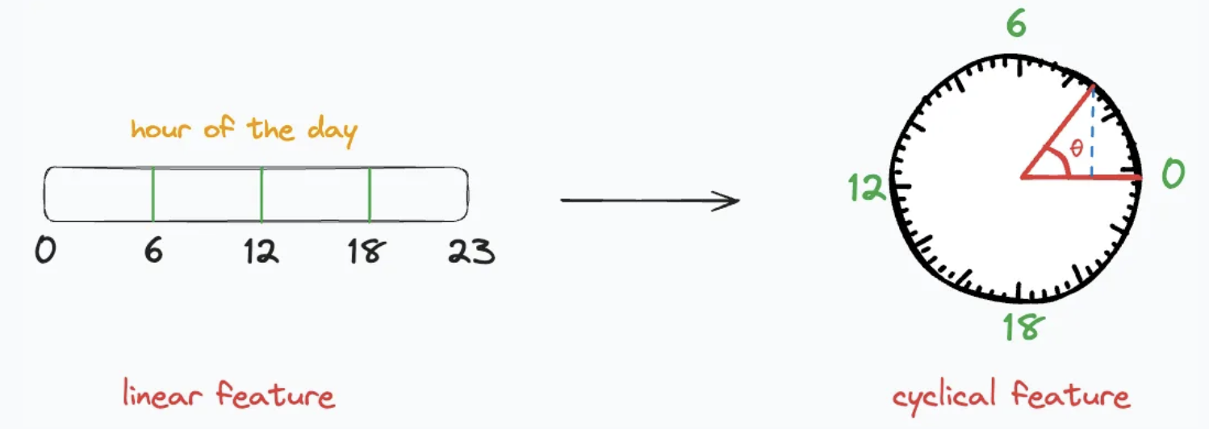
4 Splitting and Preprocessing
Splitting:
Used a stratified train-test split to divide the dataset into 80% training + validation and 20% test.
Within the 80% training + validation portion, applied 4-fold StratifiedKFold cross-validation
Preprocessing:
StandardScaler → numerical & linear ordinal features
OneHotEncoder → categorical features (payment_type, state)
Cyclic encoding → temporal features (month, day_of_week)
Picture from blog cyclical-feature-engineering
Notes:
After finishing the EDA，I used a stratified train-test split, keeping 80% for training and validation, and 20% for testing.
I used stratification because, as I found during EDA, the dataset is highly imbalanced .
Within the 80% portion, I applied 4-fold StratifiedKFold cross-validatio.
For preprocessing, I standardized numerical and ordinal features using StandardScaler,
one-hot encoded categorical features,
and applied cyclic encoding to temporal features like month and day of week.
I chose cyclic encoding because these time features are naturally circular — for example, December and January are close in time even though their numeric values, 12 and 1, look far apart.
If treated as linear numbers, the model would incorrectly assume a large gap between them.
Cyclic encoding fixes this by mapping time points onto a circle using sine and cosine.

Slide 8
Q&A

